Slide 1
Module Topics
Selection Sort
Insertion Sort
Bubble Sort
Mergesort
Quicksort
Heap Sort
Radix Sort

Slide 2
Selection Sort: Example
Selection sort is a sorting algorithm that selects the smallest element from an unsorted list in each iteration and places that element at the beginning of the unsorted list.

Slide 3

Selection Sort: Video Example

Slide 4
Insertion Sort: Illustration

Slide 5

Insertion Sort: Video Example

Slide 6
Bubble Sort: Example
Start at the beginning of the array
Compare the first item to the second
If the items are out of order, swap them and step forward in the array
Continue doing this until you reach the end of the array
Each pass through the array will always end with at least one value being placed at the correct index

Slide 7
Bubble Sort: Extra example
Start at the beginning (or end) of the array
Compare the first item to the second
If the items are out of order, swap them and step forward in the array
Continue doing this until you reach the end of the array
Each pass through the array will always end with at least one value being placed at the correct index

Slide 8

Bubble Sort: Video Example

Slide 9
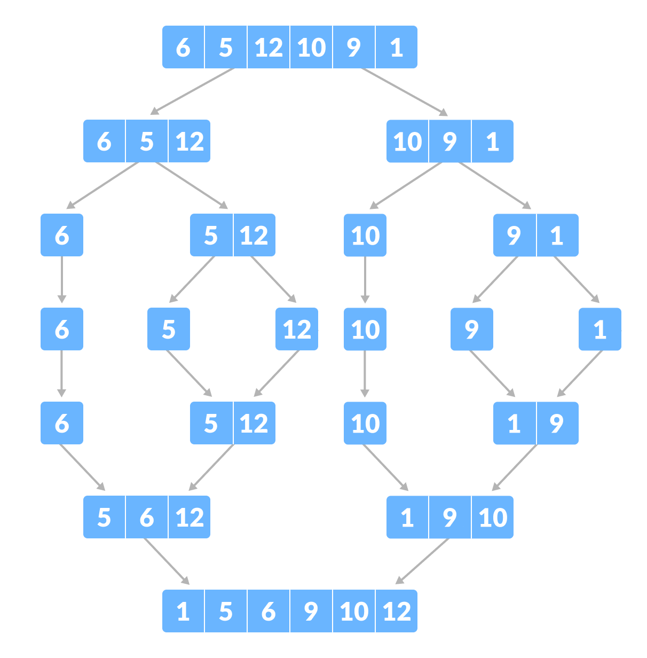
Merge Sort: Illustration

Slide 10
Merge Sort: Extra illustration

Slide 11

Merge Sort: Video Example

Slide 12
Quick Sort: Illustration
Select the Pivot Element
Rearrange the Array
Divide Subarrays

Slide 13
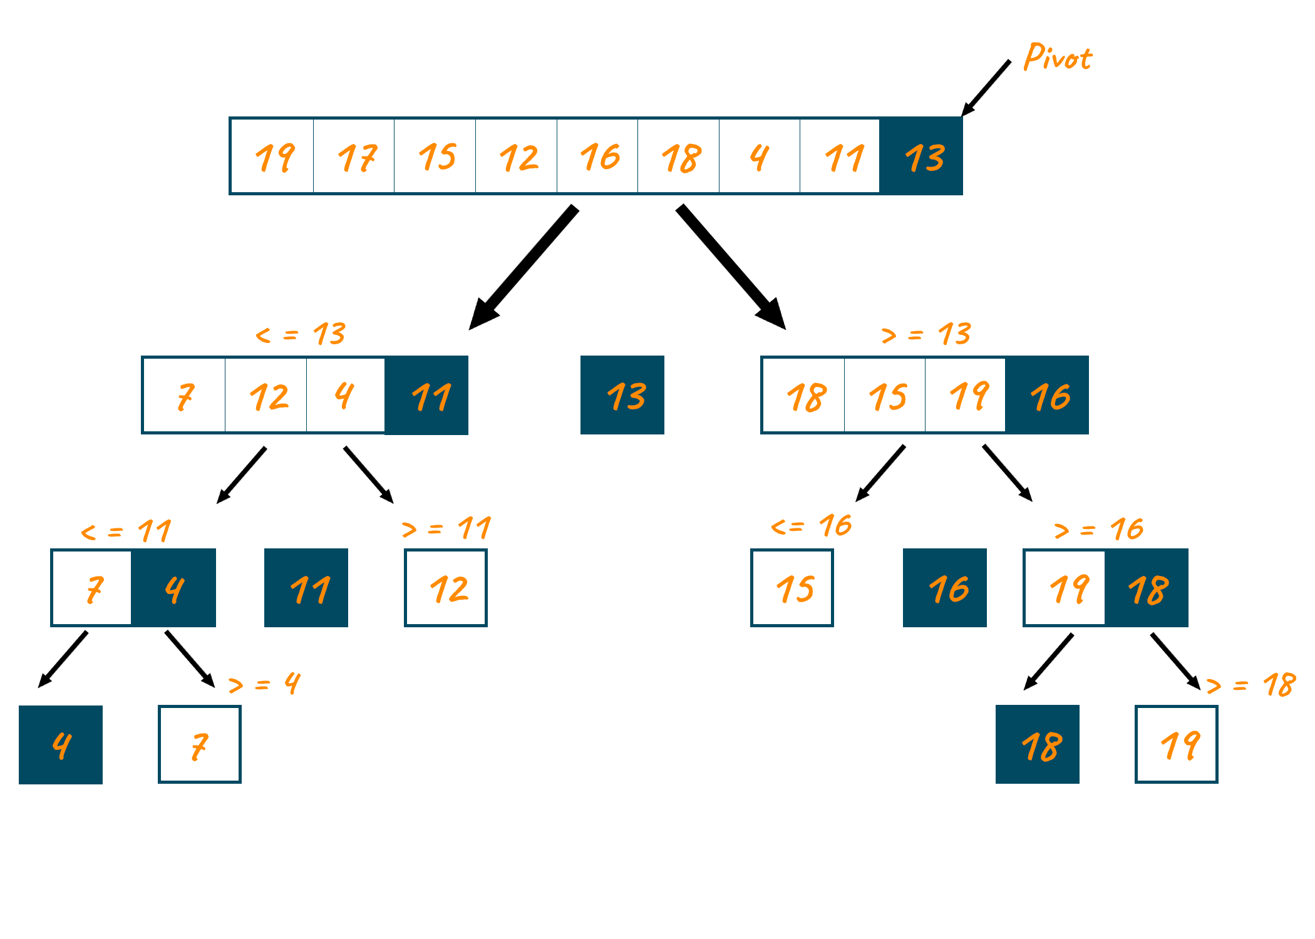
Quick Sort: Extra illustration

Slide 14

Quick Sort: Video example

Slide 15
Heap Sort: Illustration

Slide 16

Heap Sort: Video Example

Slide 17
Radix Sort: Illustration

Slide 18
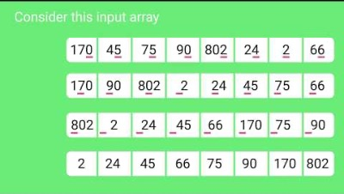
Radix Sort: Video Example

Slide 19
Summary of Sorting Algorithms
Algorithm | Time | Notes
Selection sort | O(n²) | in-place slow (good for small inputs)
Insertion sort | O(n²) | in-place slow (good for small inputs)
Merge sort | O(n log n) | fast (good for large inputs)
Quick sort | O(n log n) expected | randomized fastest (good for large inputs)
Heap sort | O(n log n)
Radix sort | O(nd) | d is number of digits in largest number basically linear when d is small

